Slide 1
FINAL PROJECT TEMPLATE

Slide 2
THREAT SUMMARY
Summary of Situation: (Summarize the current threat situation) After the new legislation passed 3 hospitals are hit by ransomware attacks. This is started when an employee in hospital A opened an attachment sent in email, after that they are unable to logon to their central management system. After that 5 more hospitals are attacked in the same way. Finally, we can say that hospital x is also in danger.
Asset: (What assets are being targeted?)windows systems, hospitals sensitive information, patient data, central log management system
Impact: (What part of the CIA triad is being impacted?) in ransomware attack the data is not Available to the user until some amount paid so in CIA system there is loss of Availability,
Threat Actor: (Identify potential threat actors) threat actor might be external actor like cyber criminal (threat type is intentional attack on technology) for financial gain/profit , Internal threat actor like security unaware employee in technology department who is unintentional. Insider threat actors: an employee who can take the revenge intentionally, 3rd party insider , ex-employee.

Slide 3
THREAT SUMMARY
Example: cyber criminal group LAPSUS$ is in large-scale social engineering and extortion operations, including destructive attacks without the use of ransomware, TA505 is also a cyber criminal group known for changing malware. “Wizard Spider” has conducted ransomware campaigns against a variety of organizations, ranging from major corporations to hospitals.
Threat Actor Motivation: (Share potential motivations behind the attacks)cyber criminals are financially motivated group, they attack the organization for their own profit, money (in this scenario attackers asked to pay some ransome in the form of bit coins to decrypt the files ). Hacktivists carry out attacks to advance political or social causes. Sometimes it also might be for revenge, the threat actor here is an employee or an ex-employee who is intentional.

Slide 4
VULNERABILITY SCANNING TARGETS
Common Threat Actor Techniques: (Share attack methods commonly used by the threat actor)Ransomware attacks, social engineering techniques other types of attacks are malware, phishing , DDos attack, backdoor, spoofing.. and more
Techniques used examples: threat actor may used SMTP for C2 communications, Data encrypted for Impact, Inhibit system recovery, command and scripting interpreter, Logon AutoStart, Account access removal, Data destruction, Account manipulation .
Summary of scan targets:
Number of devices scanned: one
Device type: windows virtual machine
Primary purpose of device: (describe what the devices are used for and what kind of data might be on them)
(insert 2 screenshots from scan configuration window – one of the settings tab and one of the plugins tab)

Slide 5
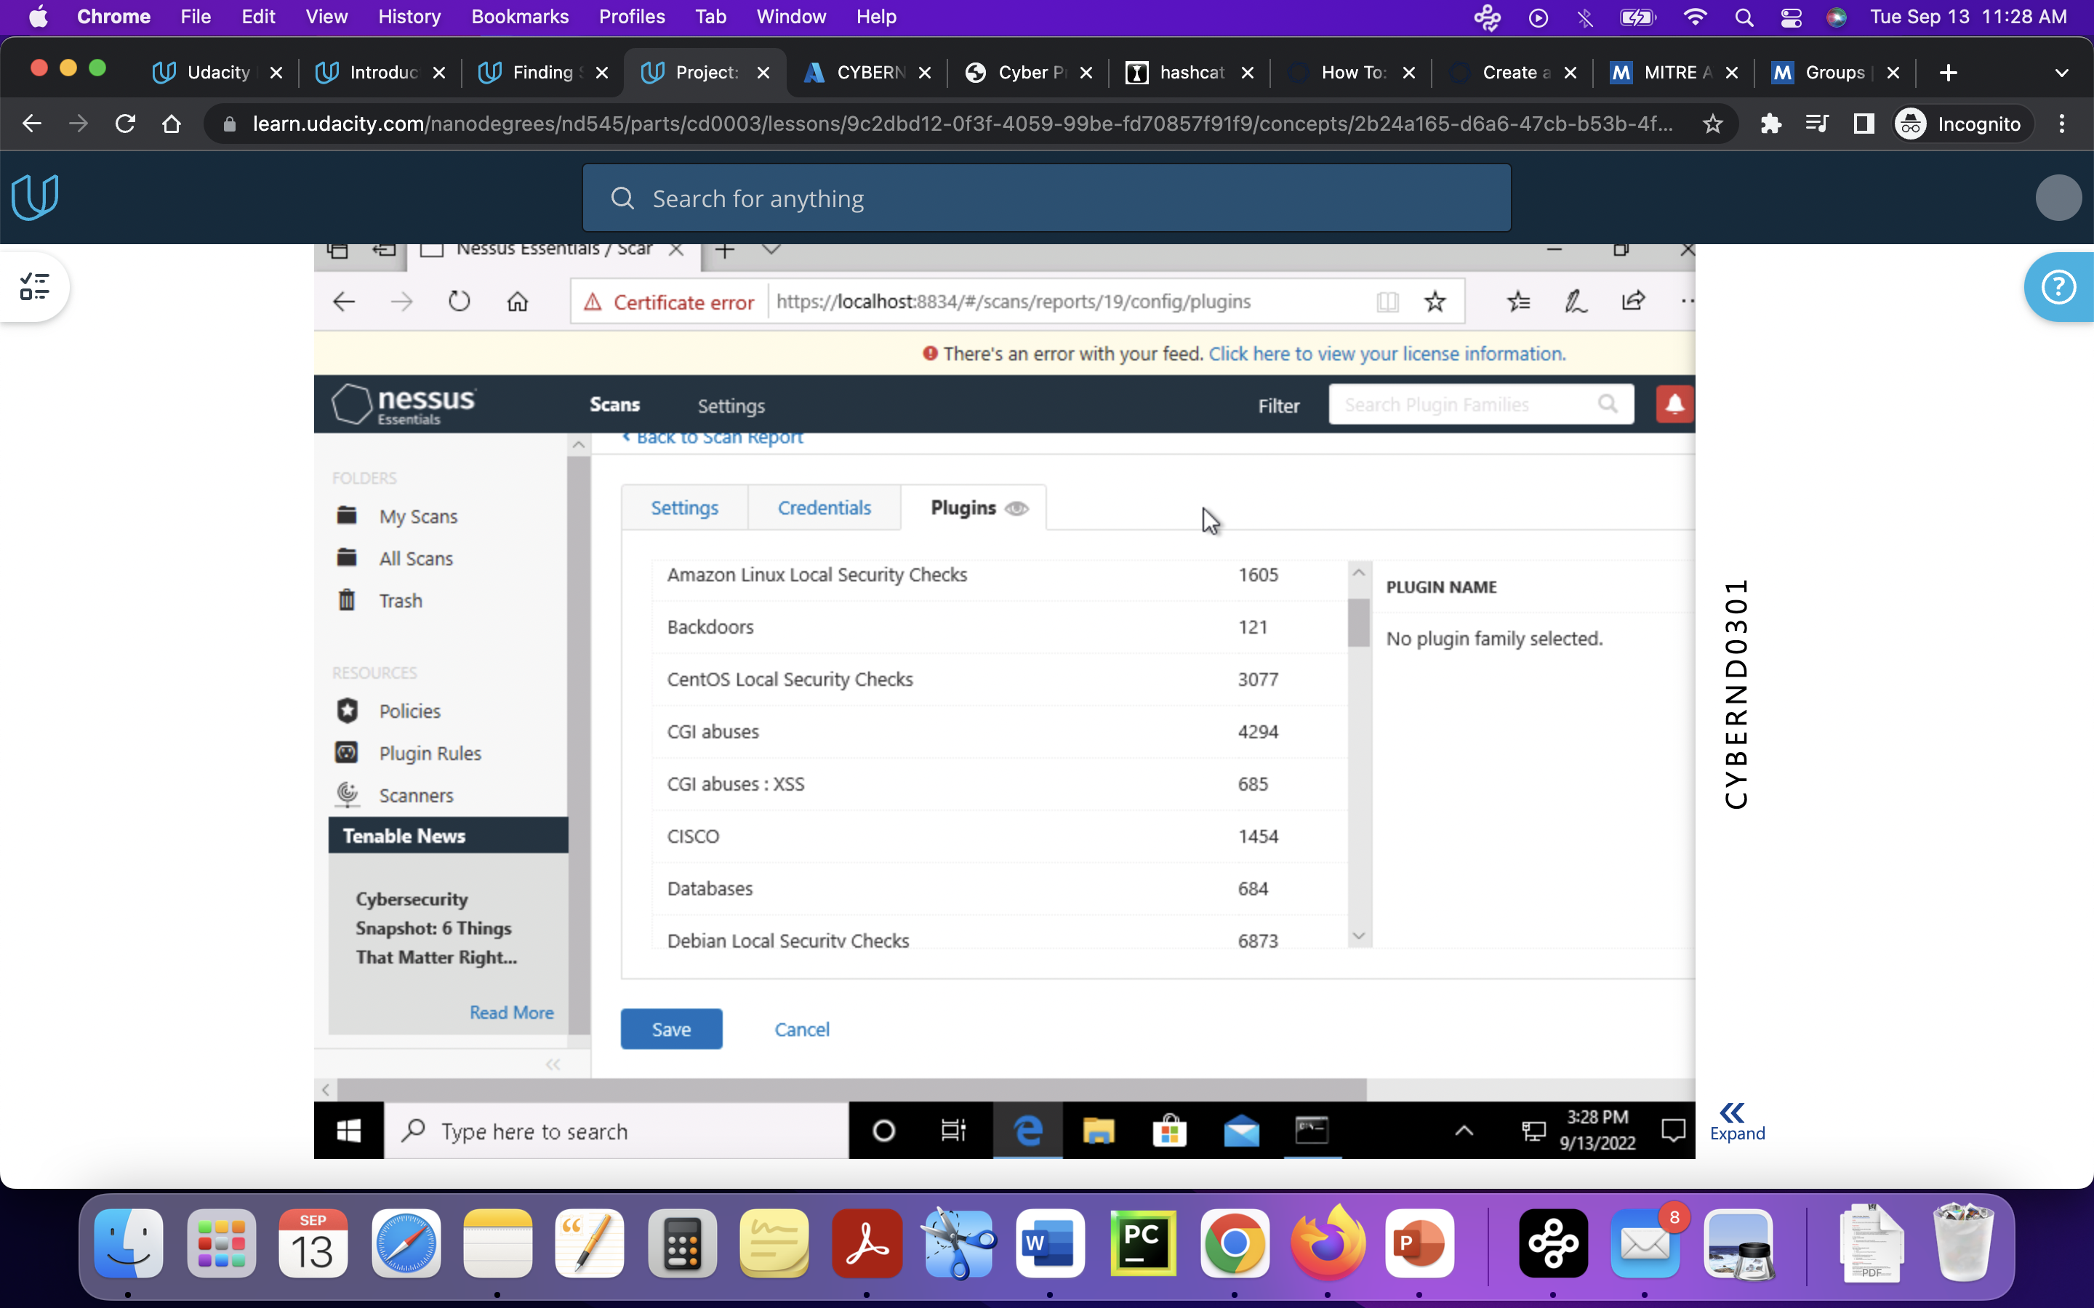
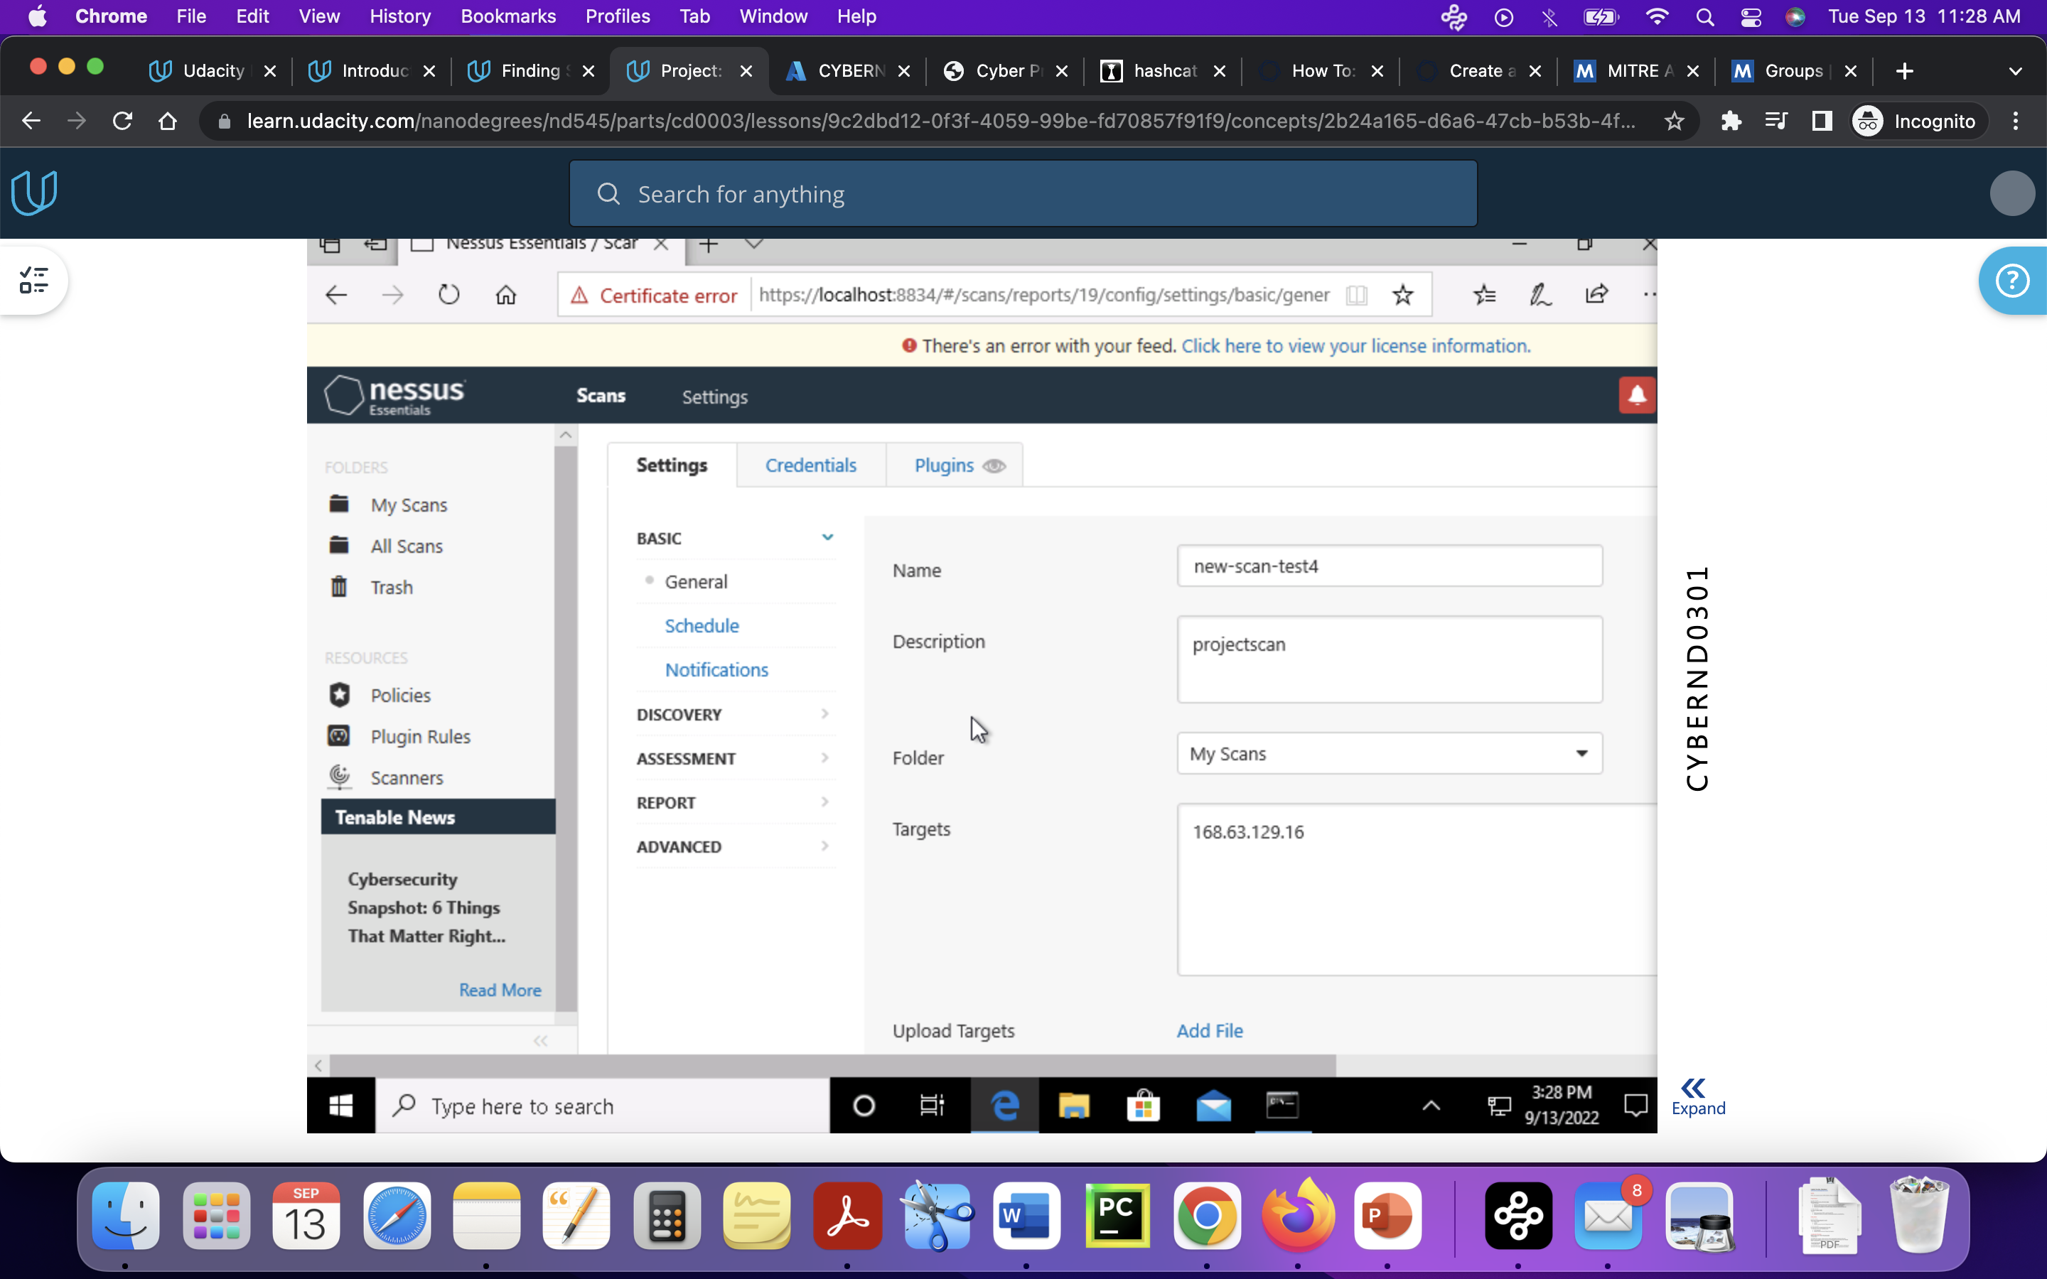

Slide 6
VULNERABILITY SCAN RESULTS
Summary of findings:
Total number of actionable findings:
Critical:0
High: 0
Medium:2
Low:1
(insert screenshot from scan results dashboard)

Slide 7
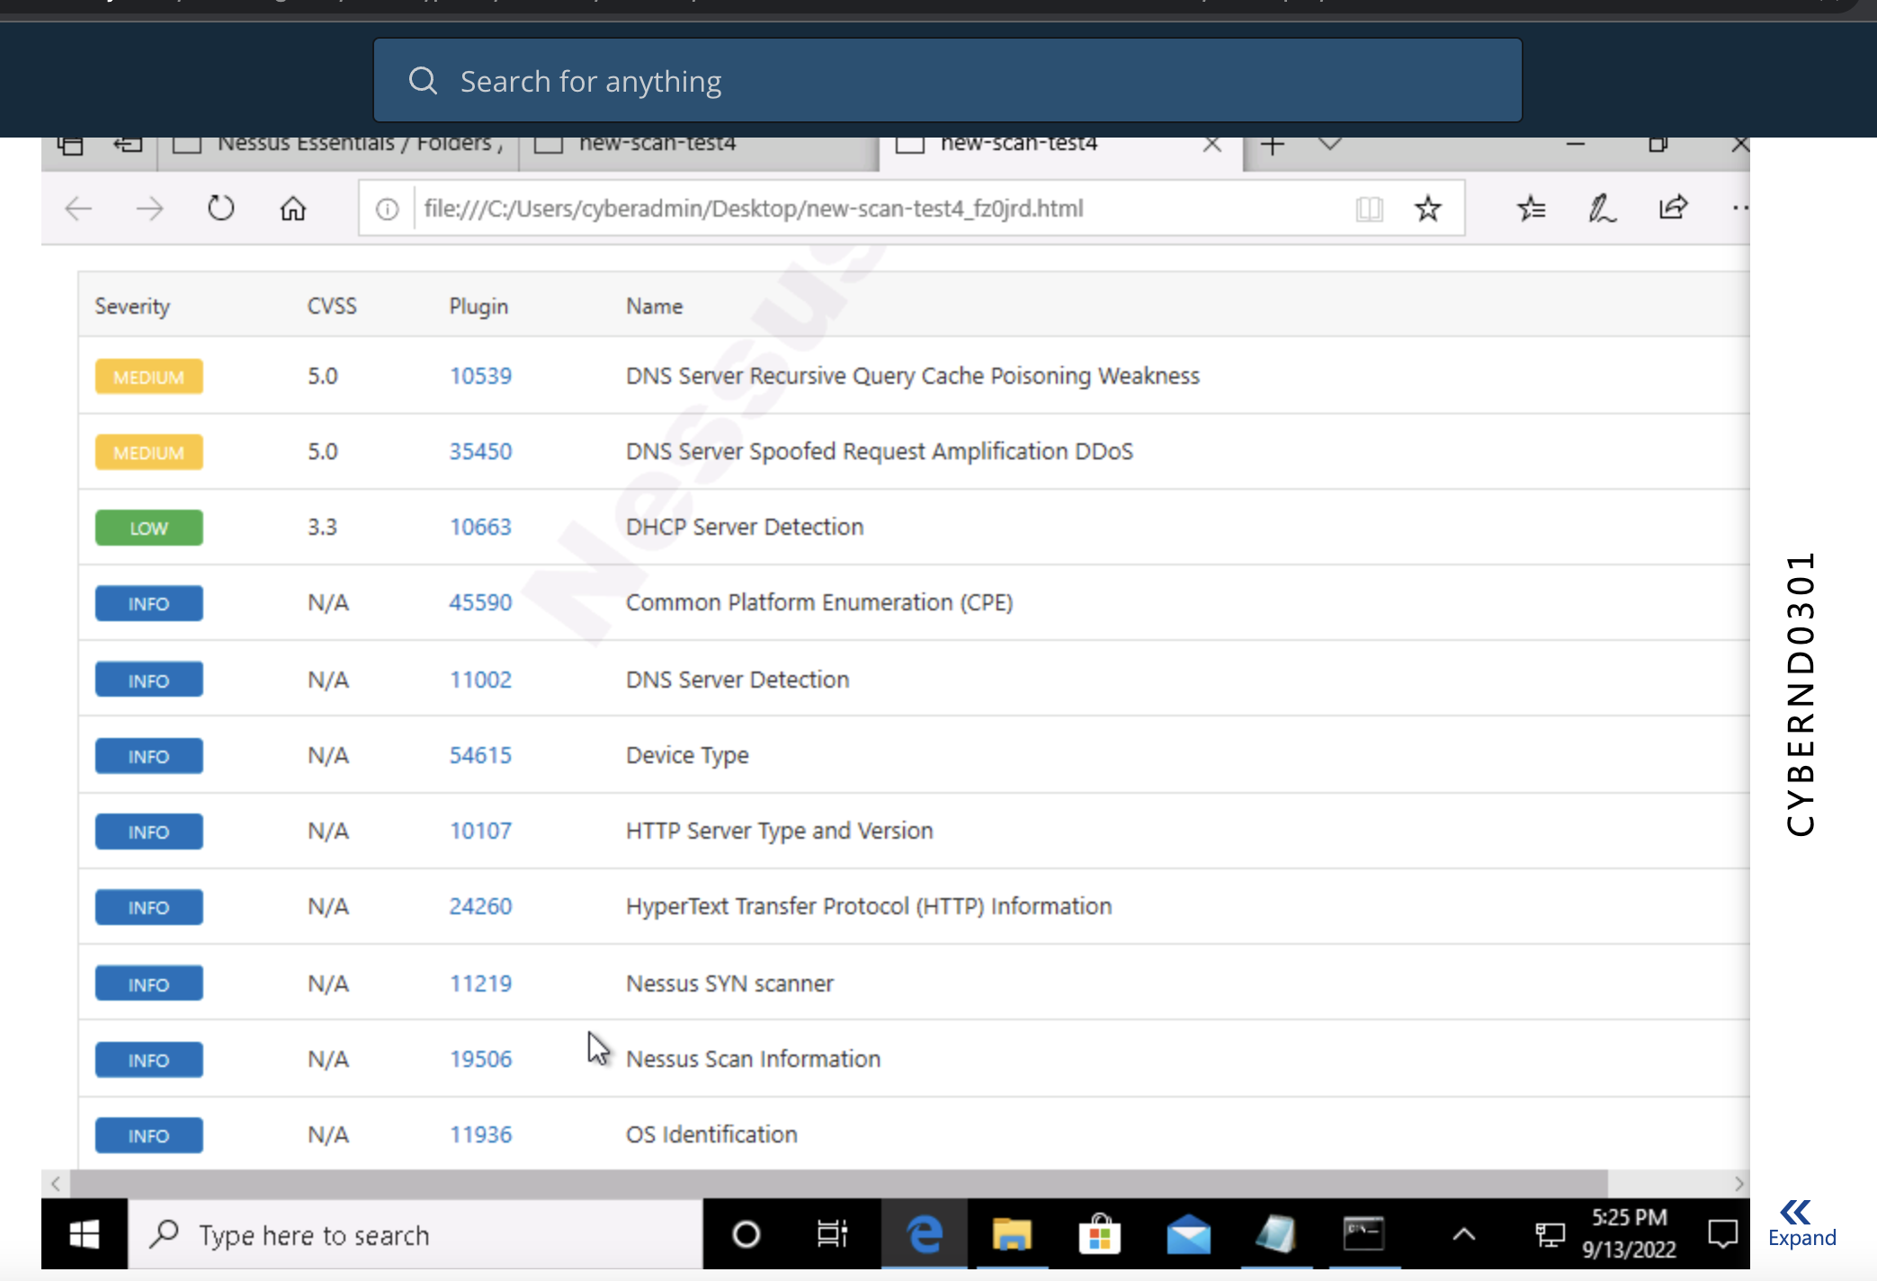

Slide 8
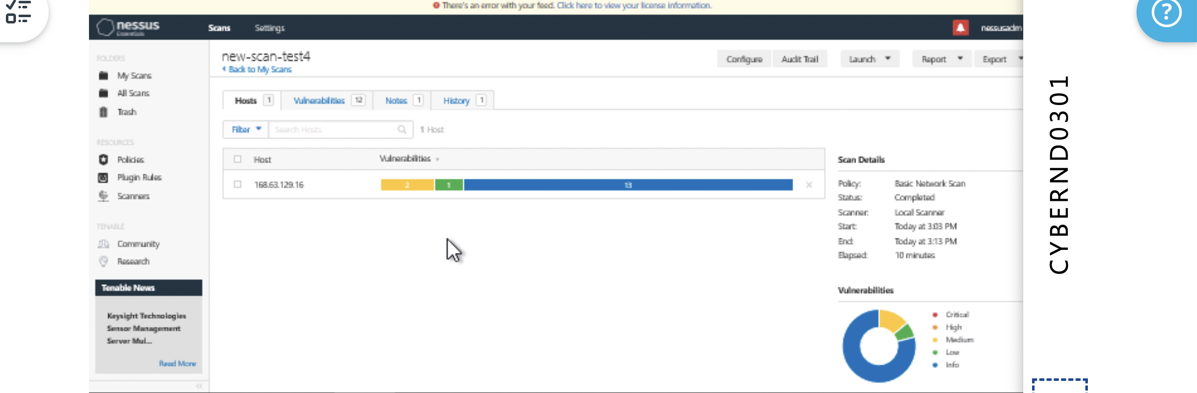

Slide 9
REMEDIATION RECOMMENDATION
Fix within 7 days
Finding | Severity Rating | Recommended Fix
Fix within 30 days –based on severity
Finding | Severity Rating | Recommended Fix
DNS server recursive query cache poisoning weakness | 5.0 -medium | Restrict recursive querys to host that should use the nameserver
DNS spoof request amplification DDOS | 5.0-meduim | Restrict access of DNS server from public network
Fix within 60 days - based on severity
Finding | Severity Rating | Recommended Fix
DHCP server detection | Low-3.3 | Applying filter to keep the info off the network and remove options not in use

Slide 10
PASSWORD PENETRATION TEST OUTCOME
Methodology: (Summarize steps taken to test password security) used hashcat tool to test passwords, -m0 = md5 hashes and –a 0 =straight/dictionary attack which uses a word list
Number of passwords tested: (insert number)6494
Number of passwords cracked: (insert number)14344391
Evidence of weak passwords:
Secret(, 0000,12345…more
(insert screenshot of cracked passwords and command used to launch attack)
Hashcat32.exe –m0 –a0 example0.hash rockyou.txt –r rules/d3d0ne.rule
Recommended steps to improve passwords security: (Summarize best practice recommendations to avoid brute force attacks in the future)use long passwords , special letters and capitals. Change the password for every 3 months. Do not share passwords with anyone. Use password manger . Do not use previous password or popular passwords which are easy to crack.

Slide 11
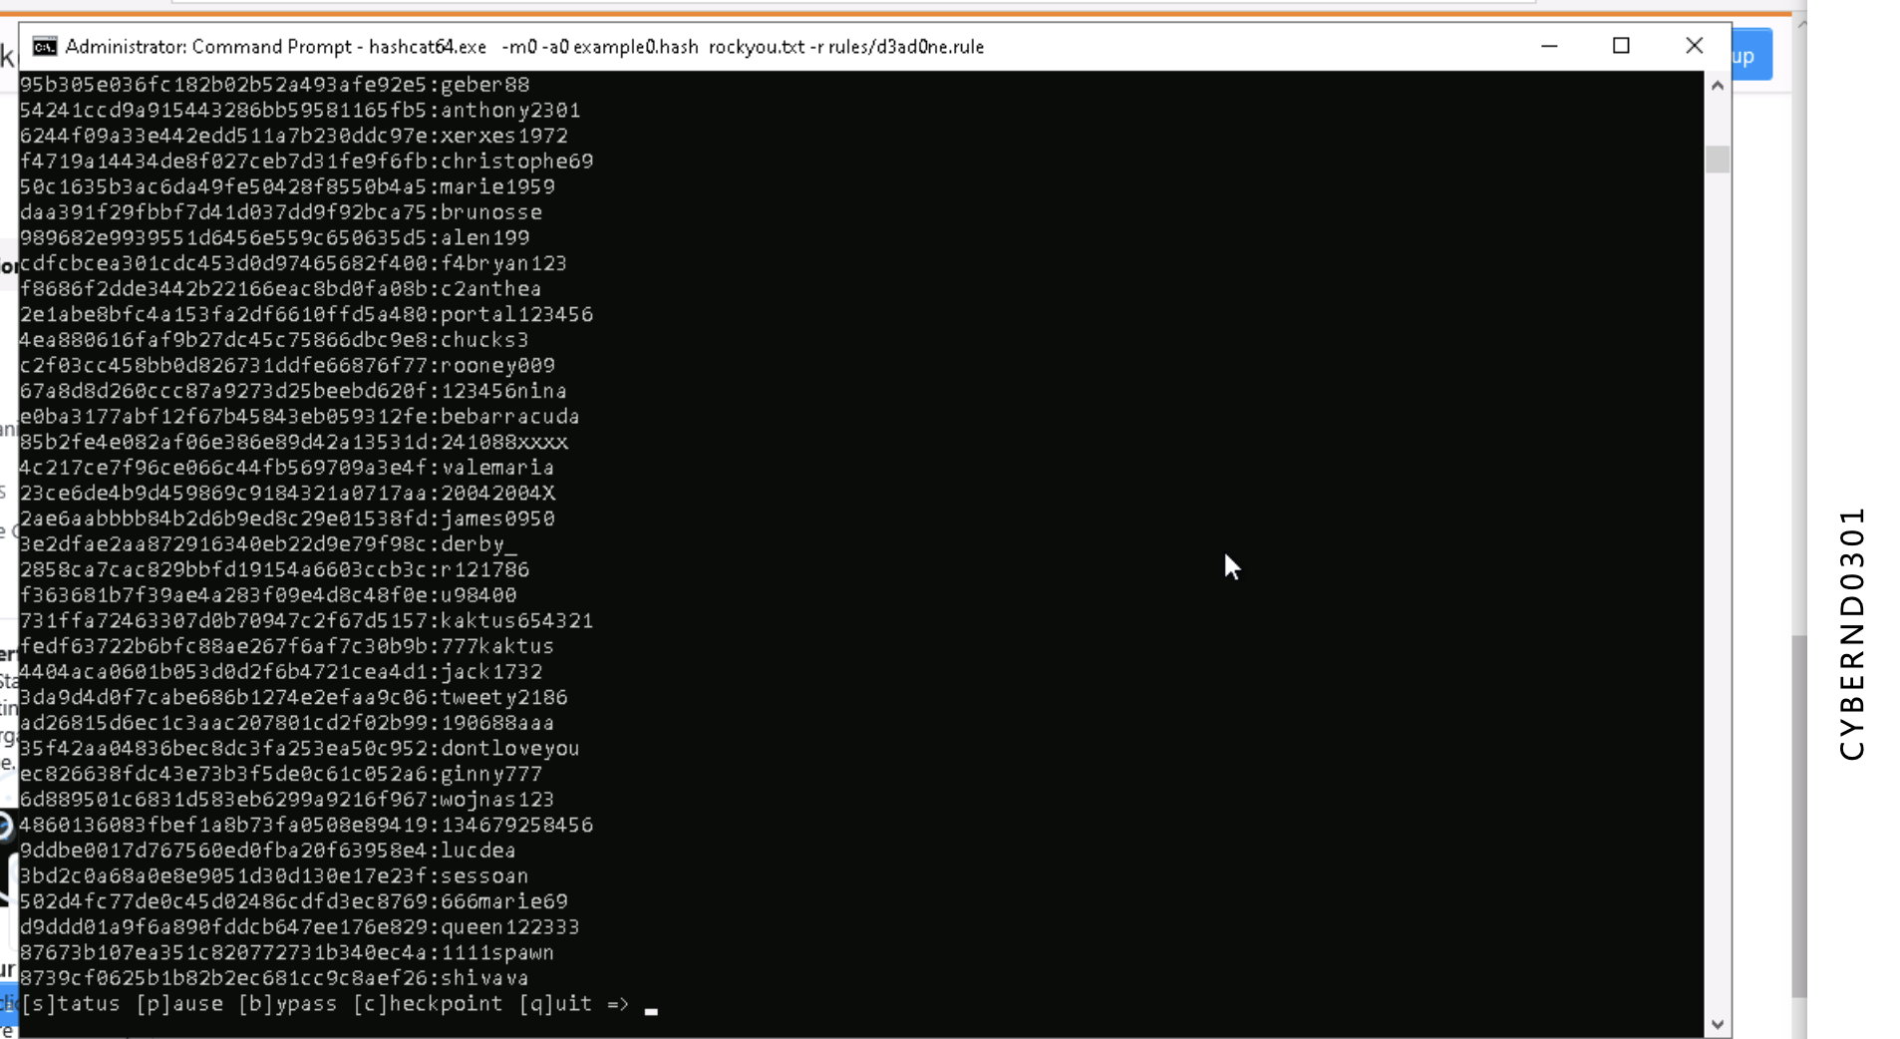

Slide 12
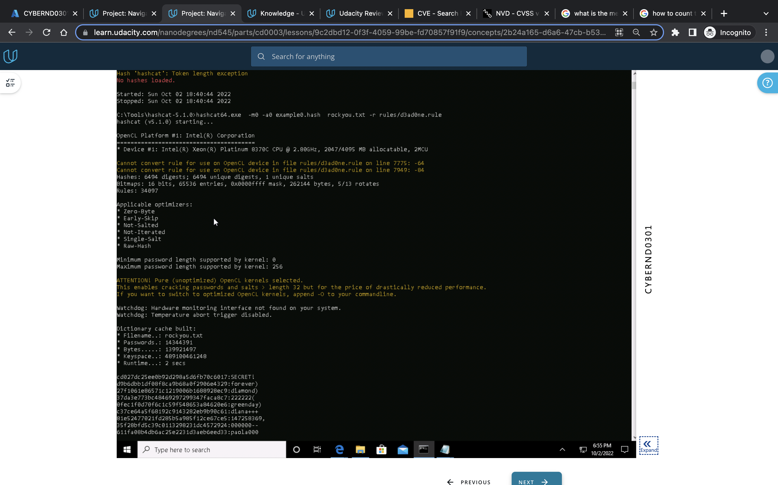
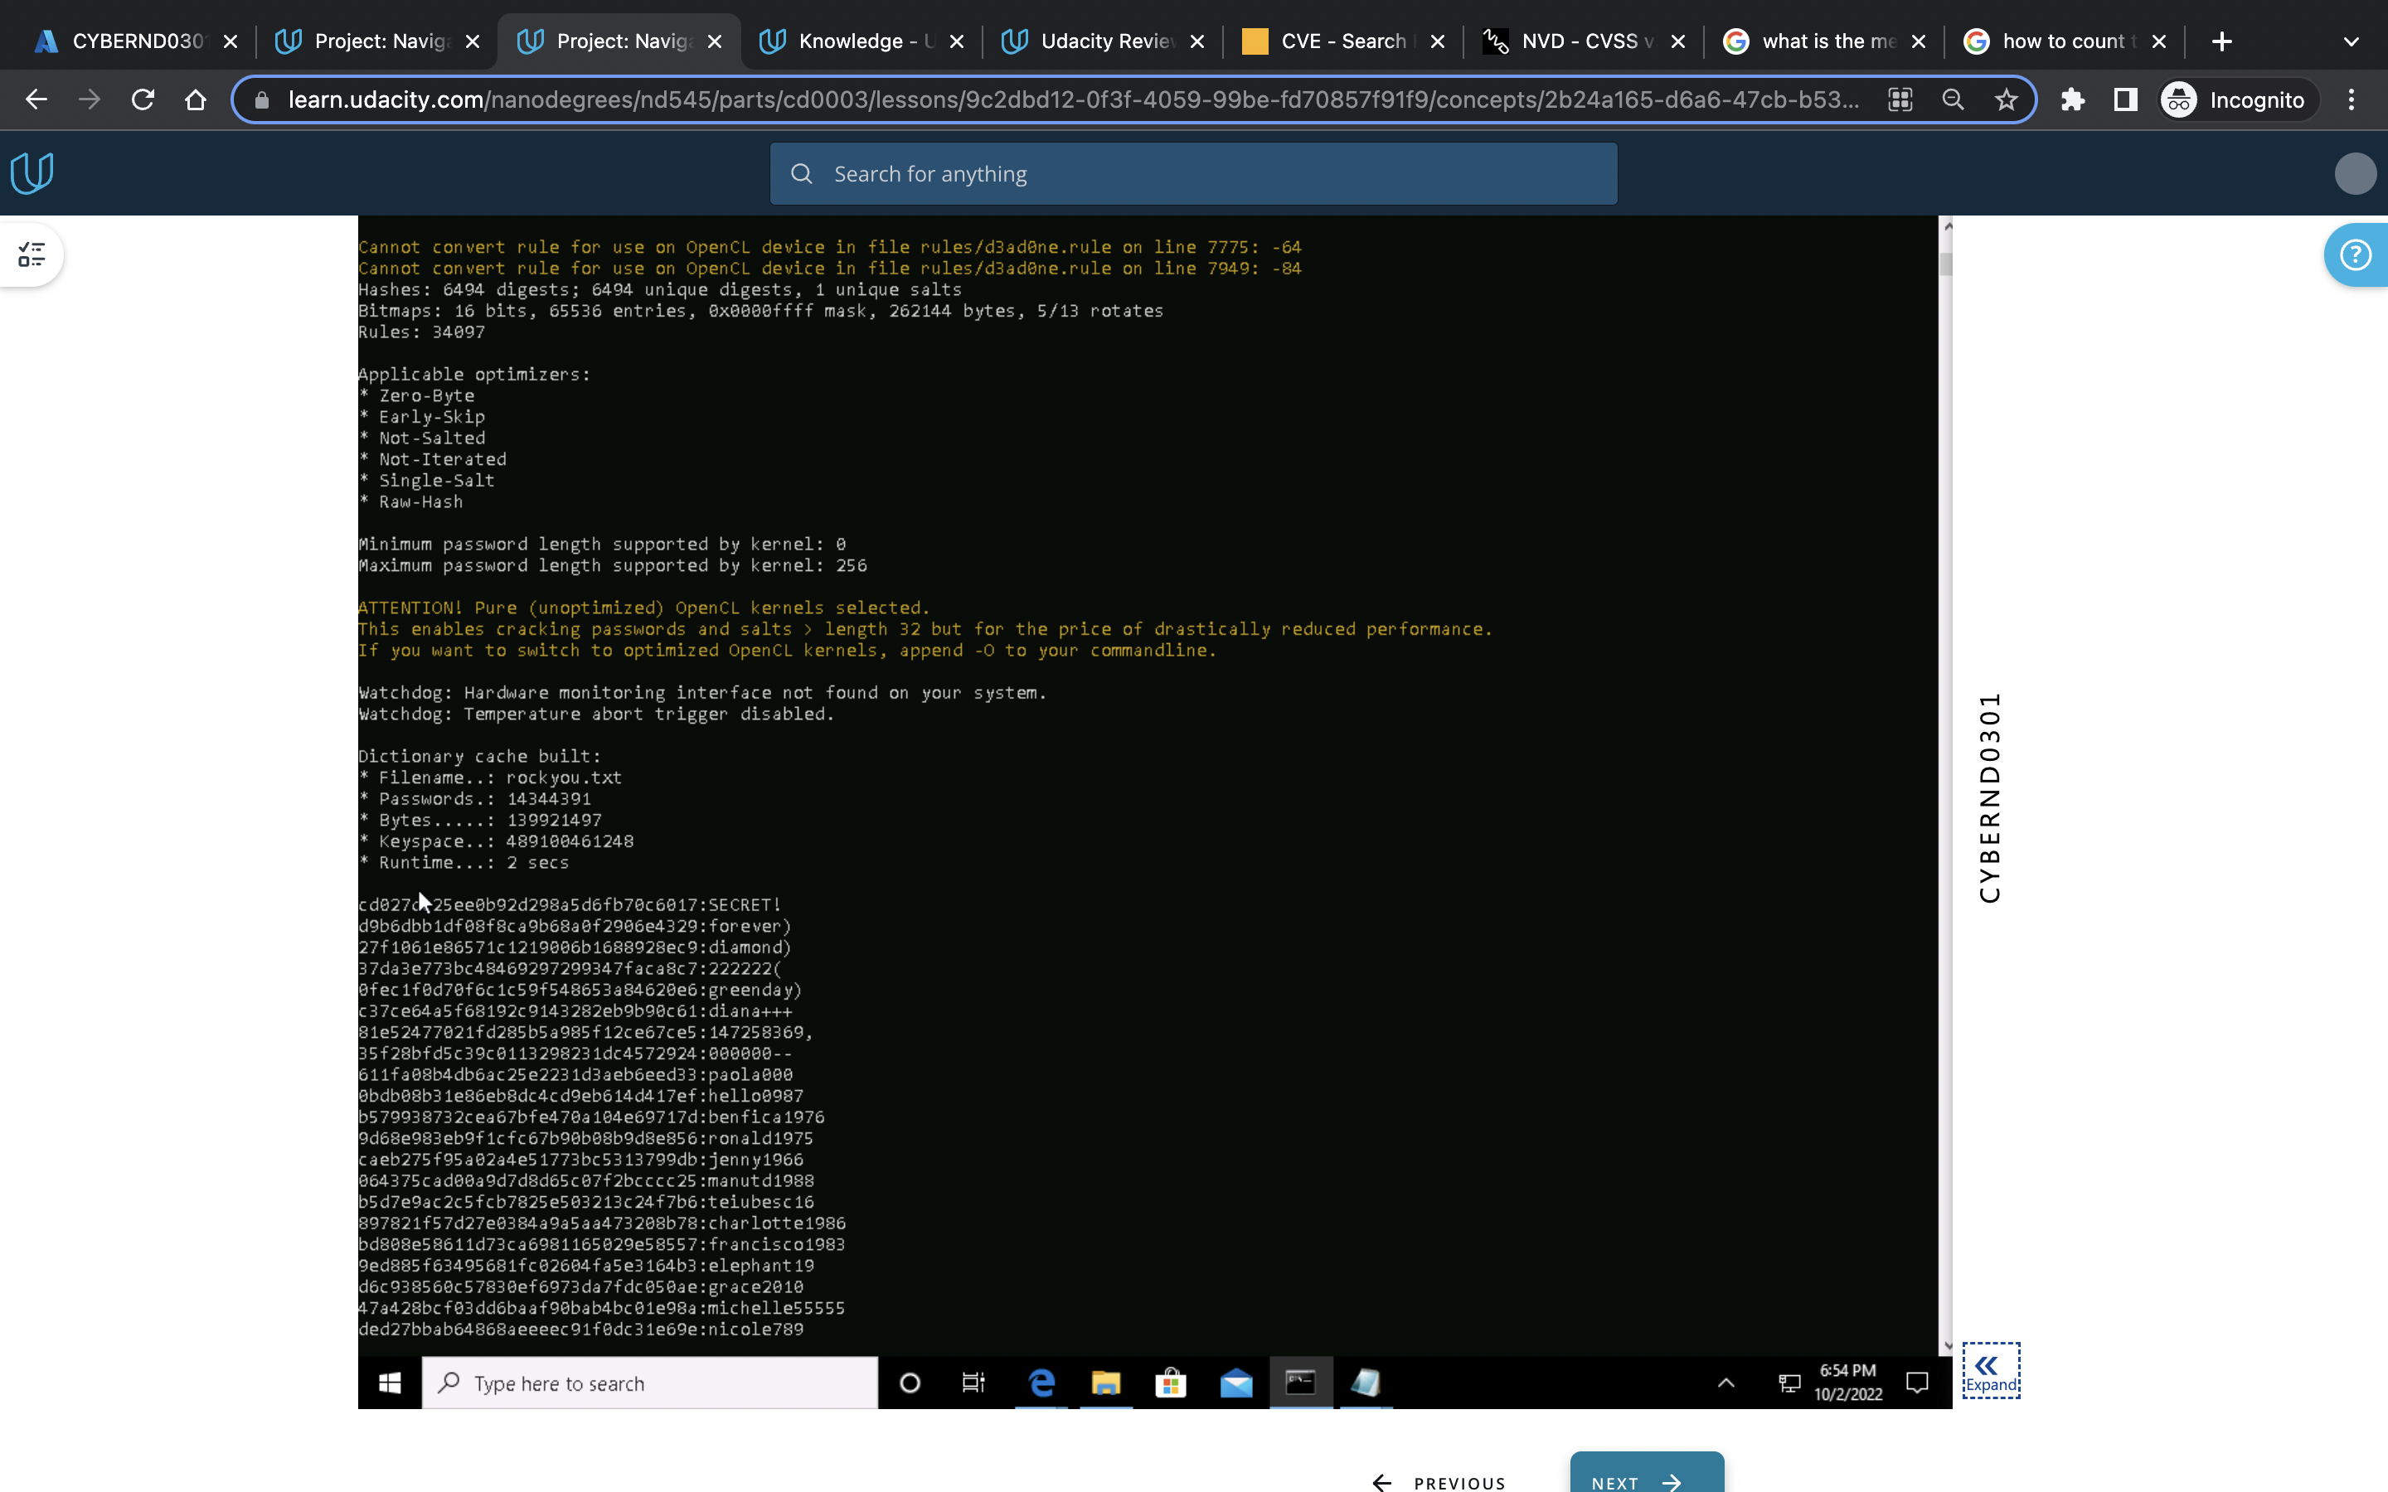

Slide 13
INCIDENT RESPONSE PRELIMINARY ASSESSMENT
Summarize ongoing incident:
What do you know so far?
Document actions or notes from the following steps of the initial incident response checklist
Step 1: Document the entity who discovers the incident :end user in a technology team opened a mail which is responsible for the ransomware attack, then a help desk team informed about the attack, finally security leader declared it as a critical incident
Step 2: Impact Considerations
a) What is the indicator of compromise? when trying to log into their centralized log management systems it shows a locked/encrypted file asking ransom to decrypt it.
b) What is the potential impact of the incident?
The control systems used to monitor patient stats are no longer available through the standard user interface. Some doctors report being unable to render treatments because they cannot view detailed information about patient status.
When attempting to log into log analysis tool, that’s no longer accessible.
c) Name of system being targeted, the operating system, and the IP address. (use lab environment machine) Windows VM, windows operating system, IP address: 168.63.129.16

Slide 14
INCIDENT RESPONSE PRELIMINARY ASSESSMENT
Step 3: a) Is the incident confirmed? Or an indicator of compromise that’s not yet verified?
YES , the incident is confirmed
b) Is the incident contained already or still in progress? The incident is already contained in other hospitals, so it may also occur at hospital X.
c) Is the response urgent? Yes, the incident happened in the other hospitals needs manager escalation.
d) Will any response alert the attacker and if so, do we care? Yes, the attackers is asking for ransom
e) What type of incident is this? Example: virus, worm, intrusion: ransomware is a type of malware that prevents access
(Add another slide if needed)

Slide 15
INCIDENT RESPONSE PRELIMINARY ASSESSMENT
Step 4:Is safety or human life at immediate risk? - the IR team should ensure their own survival and survival of the staff as a priority. there is no risk possess to human life with the attack, so staff and IR team are safe while working on it
Step 5: As soon as possible, the regional threat manager at 999-999-9999 and the security operations center at 999-999-9999 of the incident. They will coordinate communication with other internal and external stakeholders.
Step6: Which category ticket should be opened and why? Category two - A threat to sensitive data : because after the attack they are not able to login to central log systems, patients information…which contained sensitive data.
(Add another slide if needed)

Slide 16
INCIDENT RESPONSE RECOMMENDED ACTION
Summarize recommendation to contain, eradicate, and recover:
Describe the overall recommended containment, eradication, and recovery plan
For containment: The systems which are attacked by ransomware should be removed from network , shutdown the systems, take the help of digital forensic team .
Eradication: Use end point detection and response EDR automation.
Change the passwords for the affected systems. Organization should search and purge all existing messages still pending within the mail store, Restrict permissions
Recover: restore the data from backups, patch the vulnerabilities
Documented actions and notes from the IR checklist
Step 7: (Tip: Select procedures you’d recommend for this type of incident)
Malware response procedure for ransomware attack
(Add another slide if needed)

Slide 17
INCIDENT RESPONSE RECOMMENDED ACTION
Step 8: Document whether or not you’re able to check the logs. If unable, document alternatives to understand what caused the incident
Step 9: Recommended changes: a)restore data from backups if necessary. Preserve evidence before doing this: disconnect the affected systems from the network and have a file backup.
b) Make users change passwords if passwords may have been sniffed. It will help by preventing the threat actor logging into other systems
c)Ensure the system has been hardened by turning off or uninstalling unused services: it helps protecting the system from compromise.
d)Ensure the system is fully patched.
e)Be sure real time virus protection and intrusion detection is running. IDS, IPS , antivirus are important to monitor and prevents the attacks
f)Be sure the system is logging the correct events and to the proper level.

Slide 18
INCIDENT RESPONSE RECOMMENDED ACTION
Step 12) a)Consider whether an additional policy or technology could have prevented the intrusion. Yes, there should be a secure protocol for the email server to prevent/block the suspected mails.
b)Was the incident response appropriate? How could it be improved? Yes, the given incident response plan is appropriate, but it might need some modifications, like notifying the stake holders, patients asap and training the staff after hiring, hardening the systems by patching the vulnerabilities…more
c)Were the incident-response procedures detailed and did they cover the entire situation? How can they be improved? Yes, the plan covers preparation, detection, and analysis, recover stages
d)What changes can be made to prevent a re-infection? To prevent from re-infect, first the infected system should be disconnected from network and restore the files for backup and then patch the vulnerabilities in all the systems, do the forensics on the affected system to find the threat actor, harden the system by using IPS, firewall, secure email services finally educate the employees
e)What lessons have been learned from this experience? in my opinion the “Health law” should be kept secret between the higher officials and sensitive information should be encrypted and take precautions for social engineering , make file permissions are owned by privileged accounts, Applying more restrictive permissions to files and directories
(Add another slide if needed)

